Slide 1
Decoder and Encoder

Slide 2


Decoder
Digital information represented in some binary form must be converted into some alternate binary form.
$n$ to $2^{n}$-line decoder.
Only one of the $2^{n}$ output lines responds, with a logic-1, to a given input combination of values on its $n$-input lines.

Slide 3
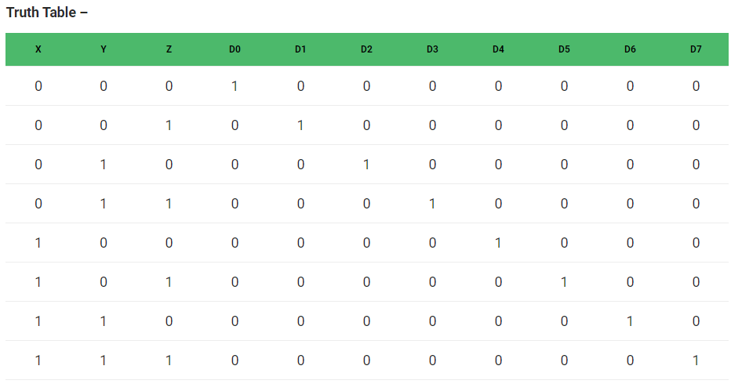
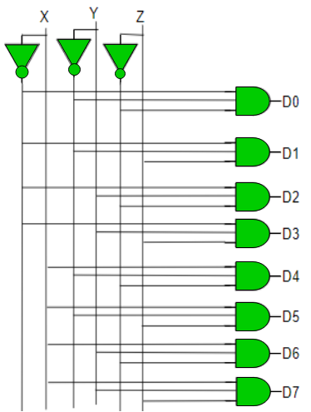
Decoder 3-8
D0 = X’ Y’ Z’
D1 = X’ Y’ Z
D2 = X’ Y Z’
D3 = X’ Y Z
D4 = X Y’ Z’
D5 = X Y’ Z
D6 = X Y Z’
D7 = X Y Z

Slide 4
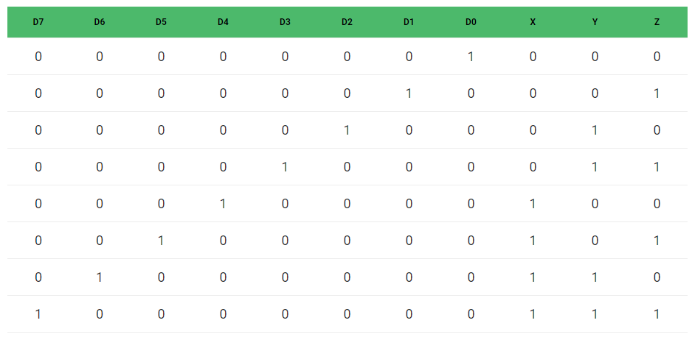
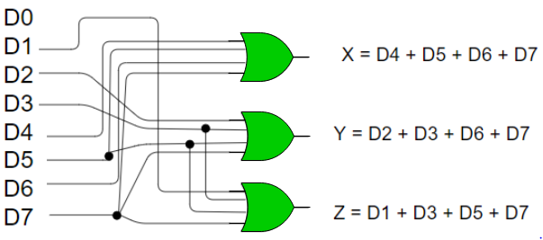
Encoder 8-3
X = D4 + D5 + D6 + D7
Y = D2 +D3 + D6 + D7
Z = D1 + D3 + D5 + D7

Slide 5
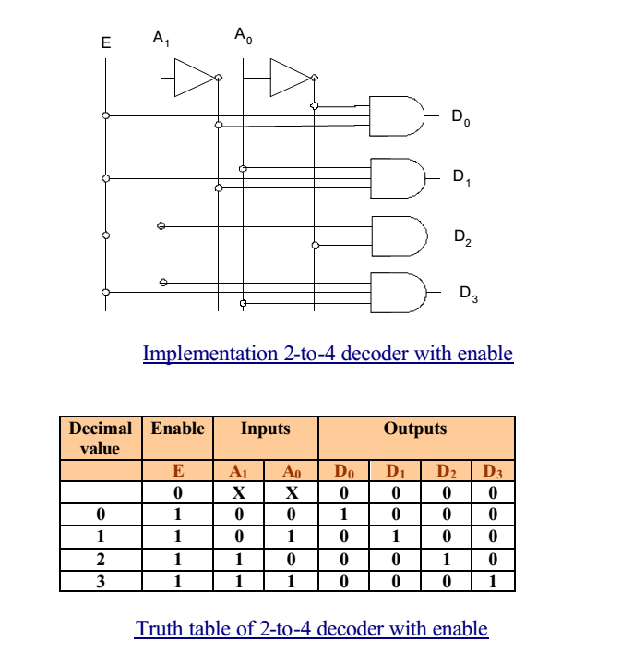
2-4 decoder with enable

Slide 6
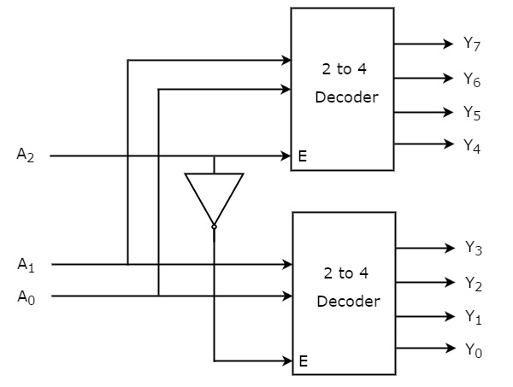
Using 2-4 construct 3-8 decoder

Slide 7
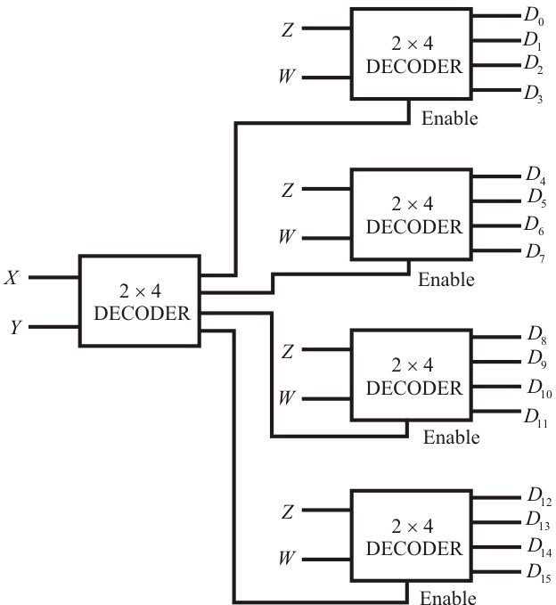
Using 2-4 construct 4-16 decoder

Slide 8
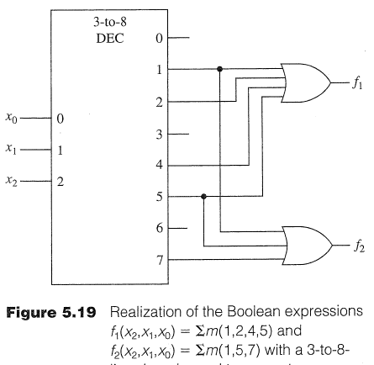
Minterms using OR Gates

Slide 9
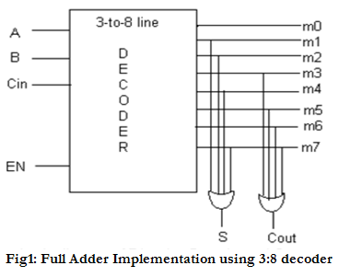
Full adder implementation using 3-8 Decoder

